Slide 1

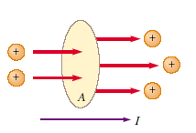



Electric current and Resistance
Whenever there is a net flow of charge through some region, a current is said to exist.
Suppose that the charges are moving perpendicular to a surface of area A, The current is the rate at which charge flows through this surface.
If Q is the amount of charge that passes through this area in a time interval t, the average current Iav is equal to the charge that passes through A per unit time:
If the rate at which charge flows varies in time, then the current varies in time; we define the instantaneous current I as the differential limit of average current:

Slide 2
It is conventional to assign to the current the same direction as the flow of positive charge.
In electrical conductors, such as copper or aluminum, the current is due to the motion of negatively charged electrons. Therefore, when we speak of current in an ordinary conductor, the direction of the current is opposite the direction of flow of electrons.
However, if we are considering a beam of positively charged protons in an accelerator, the current is in the direction of motion of the protons.
In some cases—such as those involving gases and electrolytes, for instance—the current is the result of the flow of both positive and negative charges.
If the ends of the conducting wire are connected to a battery, all points on the loop are not at the same potential. The battery sets up a potential difference between the ends of the loop, creating an electric field within the wire. The electric field exerts forces on the conduction electrons in the wire, causing them to move around the loop and thus creating a current.
It is common to refer to a moving charge (positive or negative) as a mobile charge carrier. For example, the mobile charge carriers in a metal are electrons.

Slide 3
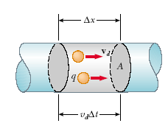

Microscopic Model of Current
We can relate current to the motion of the charge carriers by describing a microscopic model of conduction in a metal. Consider the current in a conductor of cross-sectional area A
The volume of a section of the conductor of length Δx is Δx A
the number of carriers in the gray section is nA x.
The charge Q in this section is

Slide 4







Slide 5





Materials that obey Ohm’s law and hence demonstrate this simple relationship between
E and J are said to be ohmic.
Experimentally, it is found that not all materials have this property, however, and materials that do not obey Ohm’s law are said to be nonohmic.
Ohm’s law is not a fundamental law of nature but rather an empirical relationship valid only for certain materials.

Slide 6

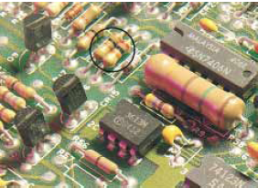

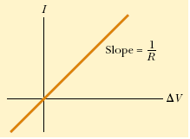
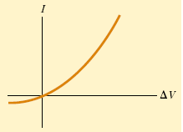

(a) Ohmic
(Conductors)
(b) Non ohmic
Semiconductors

Slide 7




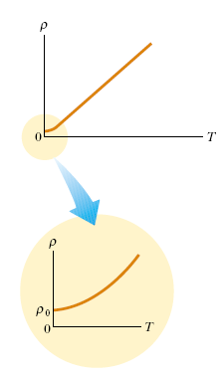

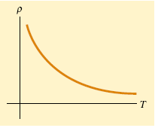
Because resistance is proportional to resistivity we can write the variation of resistance as
Resistivity versus temperature for a metal such as copper. The curve is linear over a wide range of temperatures, and increases with increasing temperature. As T approaches absolute zero (inset), the resistivity approaches a finite value 0 .
Resistivity versus temperature for a pure
semiconductor, such as silicon or germanium.

Slide 8

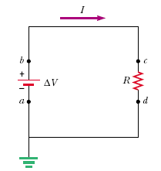

If a battery is used to establish an electric current in a conductor, the chemical energy
stored in the battery is continuously transformed into kinetic energy of the charge carriers.
The chemical energy stored in the battery is continuously transformed to internal energy associated with the temperature of the conductor.
Consider a simple circuit consisting of a battery whose terminals are connected to a resistor, as shown in Figure
Imagine following a positive quantity of charge Q that is moving clockwise around the circuit from point a through the battery and resistor back to point a. As the charge moves from a to b through the battery, its electric potential energy U increases by an amount ΔV Δ Q (where Δ V is the potential difference between b and a), while the chemical potential energy in the battery decreases by the same amount.
The charge cannot build up at any point the current is the same everywhere in the circuit.

Slide 9


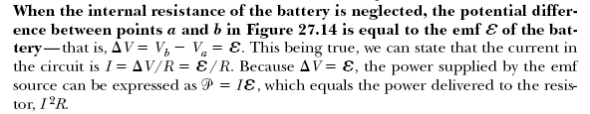
the rate at which the charge loses energy equals the power delivered to the resistor (which appears as internal energy),
In this case, the power is supplied to a resistor by a battery.
ΔV = IR for a resistor, we can express the power delivered to the resistor in the alternative forms

Slide 10
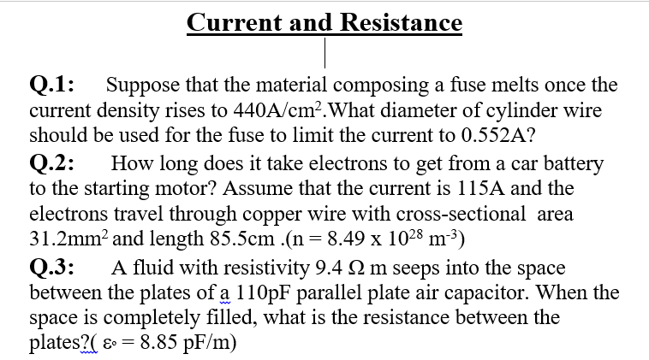


Slide 11
